Slide 1
Hamsters
Biology and Anatomy

Slide 2
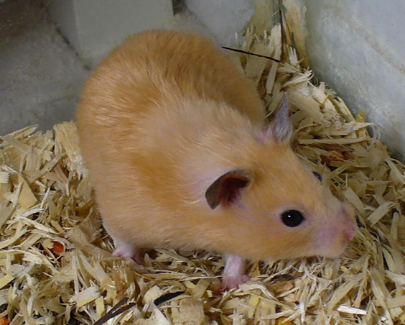
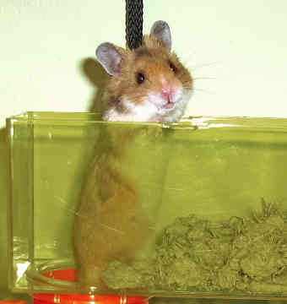
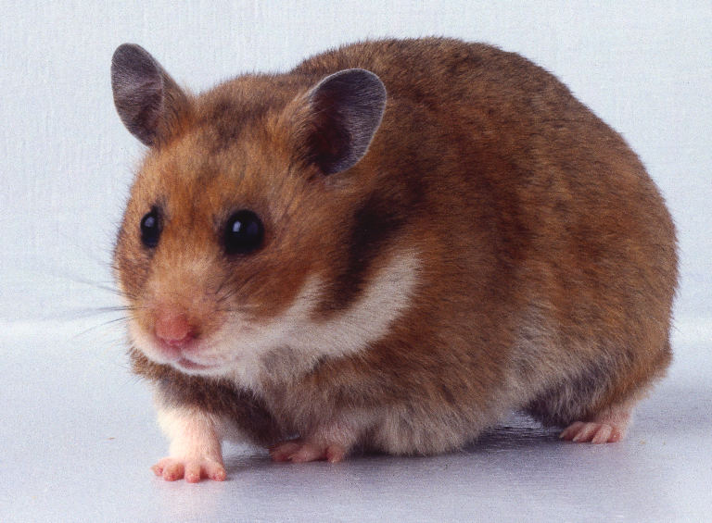
Syrian Hamster Mesocricetus auratus

Slide 3
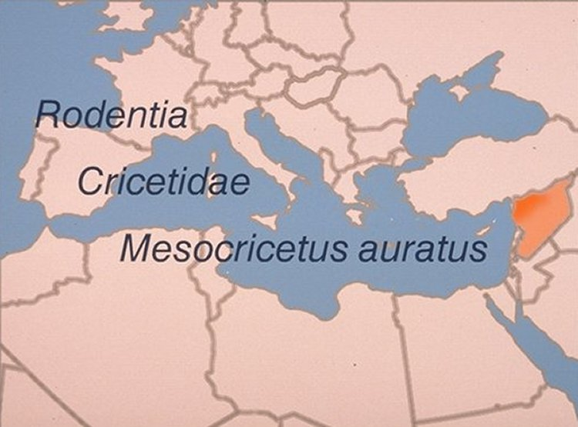
Taxonomy
The Syrian or golden hamster belongs to the order Rodentia, family Cricetidae. Its genus and species designation is Mesocricetus auratus. The Syrian hamster is a desert rodent, indigenous to northwest Syria (orange area on this map of the Mediterranean).

Slide 4
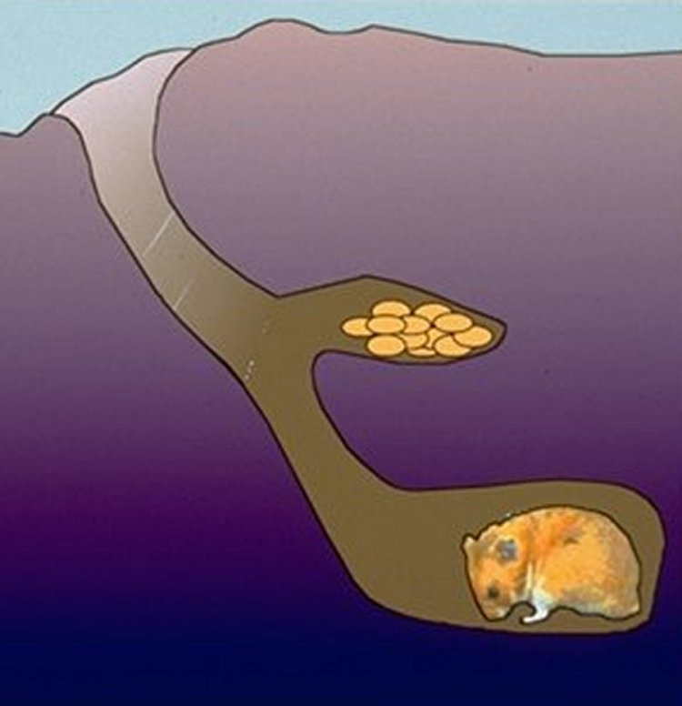
Natural History
This drawing depicts the type of deep chambered burrows Syrian hamsters dig in the wild. Note that there are separate chambers for food and for the nest. An actual burrow may extend 8 feet underground and may have additional chambers and entrances. Adult hamsters usually live alone and are very aggressive and territorial.

Slide 5
Adaptations
Syrian hamsters have made several physiologic adaptations to their desert habitat. Like the gerbil, Syrian hamsters have a lower daily water requirement than other laboratory rodents. They conserve water by decreasing water excretion through the kidneys, lungs, and colon. They also developed the ability to hibernate in order to survive long periods of cold and depletion of natural food supplies in the environment.

Slide 6
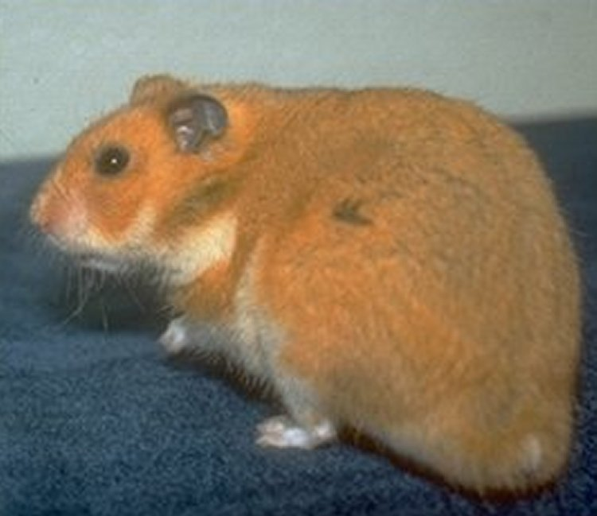
Description
The Syrian hamster has a short stocky body 15 to 20 cm long. Adult hamsters weigh from 110 to 140 g, with females slightly larger than males. Growth curves and adult body weights vary among different commercial breeding stocks..

Slide 7
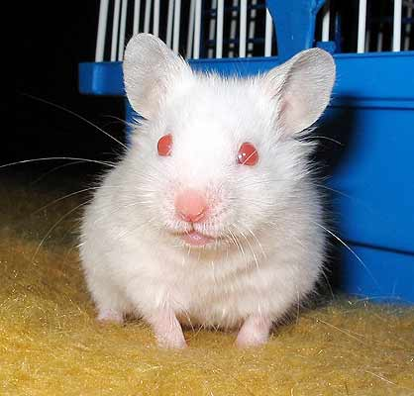
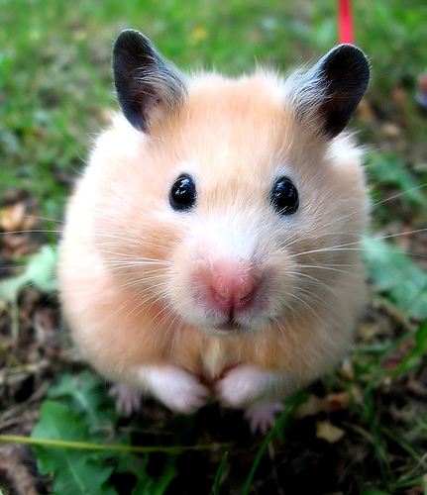
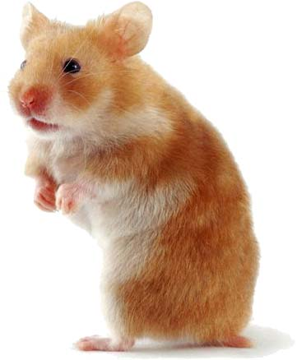
Typically, the haircoat is reddish-gold over the dorsum and sides with a gray-white ventrum. There are, however, color variations that range from albino to very dark brown among stocks and strains, as a result of genetic mutation

Slide 8
Male Flank Glands
The arrows in this image show the location of the flank glands, one of the unique anatomic characteristics of Syrian hamsters. Both male and female hamsters have complex flank glands composed of sebaceous glands, terminal hairs (indicated by the arrow), and pigment cells.

Slide 9
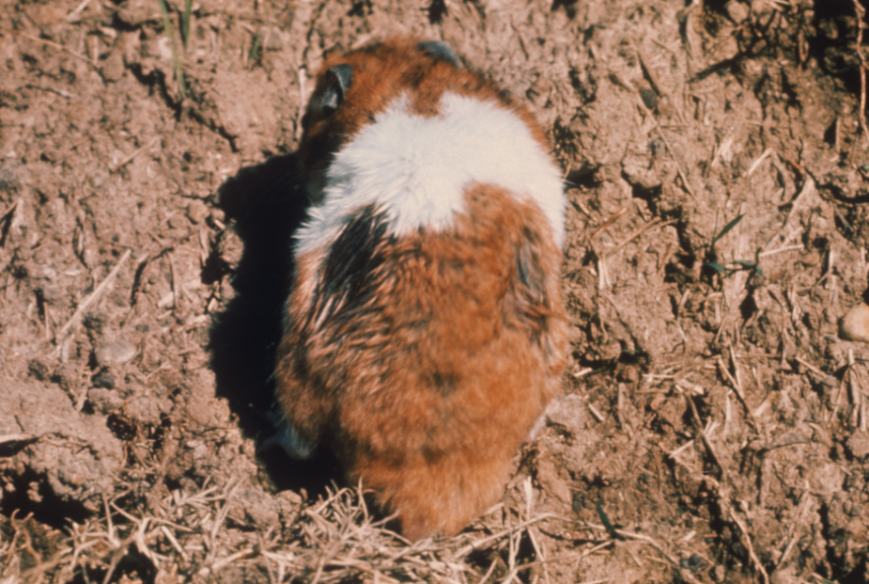
Reproduction
Flank glands, this sebaceous glands are brown in color and play a part in mating behavior and territorial marking behavior

Slide 10
Cheek pouches
Hamsters have well-developed buccal or cheek pouches beneath the skin on the lateral sides of the head, which can expand to 20 mm wide when filled and measure 30 to 40 mm long and 4 to 8 mm wide when empty

Slide 11
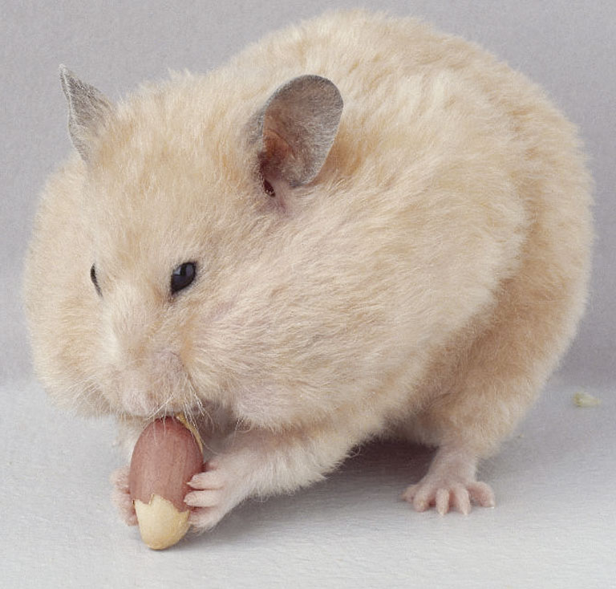
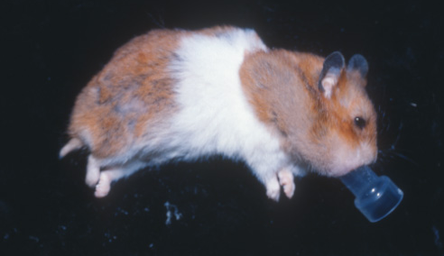
Gastrointestinal Tract
Cheek pouches- extended back to the scapula. These pouches can distend to quite a large size, allowing the hamster to transfer food and bedding from one point to another

Slide 12
The cheek pouches have been called immunologically privileged sites, because tumors from man or other animals can be transplanted to them and not be readily rejected by the hamster immune system. The reason why tumors can remain and grow in the hamster cheek pouches is not fully understood

Slide 13
The dental formula for hamsters is 2(I 1/1 C 0/0 PM 0/0 M 3/3) = 16. In other words, the Syrian hamster has 2 upper and 2 lower incisors, no canines, no premolars, and 6 upper and 6 lower molars for a total of 16 teeth. As with other rodents, hamsters have open-rooted incisors

Slide 14
Abdominal Viscera
The liver is the dark, red-brown organ filling the body cavity on the left. The liver is composed of four lobes, with the gallbladder located in the ventral medial lobe

Slide 15
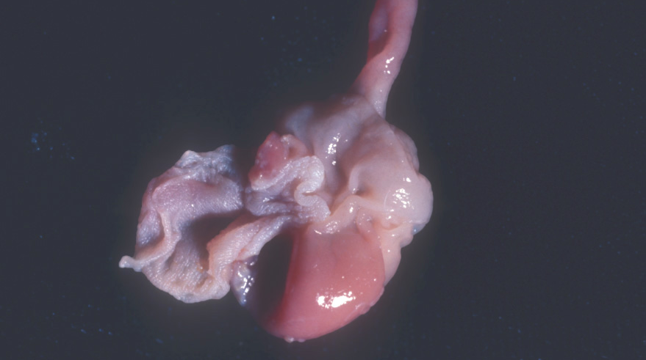
Gastrointestinal Tract
Hamsters are monogastric with their stomach divided in two portions one glandular & one nonglandular stomach
Nonglandular
forestomach
Glandular
Rodents can not regurgitate and the practice of coprophagy is believed
to assimilate certain nutrients such as B vitamins
The nonglandular forestomach acts like rumen and has higher pH than the glandular
stomach

Slide 16
The cecum is large and slightly sacculated, with apical and basal portions. The colon is relatively long compared to other rodents, suggesting an adaptation for water retention.

Slide 17
Sexing Hamsters
Sexual identification in hamsters is similar to other rodents. The anogenital distance in the male is greater than in the female (1). In the male, the penis is retracted when the animal is not mating

Slide 18
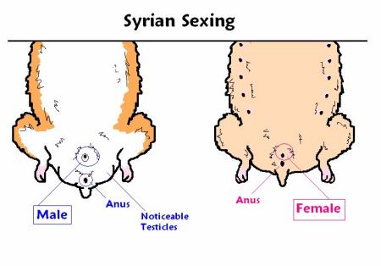
Sexing Hamsters

Slide 19
Dorsal View
Differentiation between adult male and female hamsters is relatively simple. The adult female has a blunt posterior, while the male has a bulge associated with the scrotal sac

Slide 20
Sexing Pups
Sexing of hamster pups is somewhat more difficult, but the principle is the same—the animal with the longer anogenital distance is the male. Also notice in this image, that the mammary glands are much more distinct in the female pup, which is on the left.

Slide 21
Female Urogenital Tract
This image demonstrates the arrangement of the female urogenital system, after the other abdominal viscera have been removed. The ovaries are dorsolateral to the kidneys, 3 to 4 mm long, oval, and completely enclosed in a bursa

Slide 22
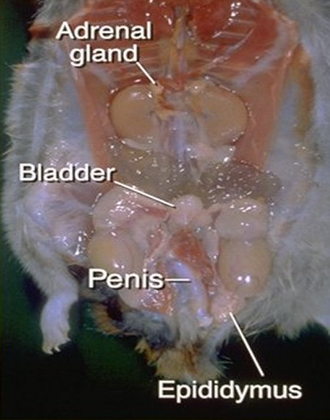
Male Urogenital System
Large fat bodies or pads cover the proximal portion of the testicles and the epididymis
Accessory sex glands include the large branched vesicular glands

Slide 23
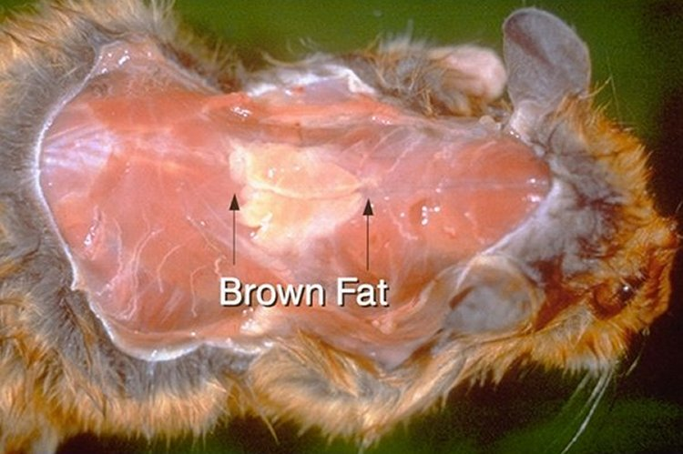
Brown fat
Brown adipose tissue or brown fat (between arrows) is primarily located ventral to and between the scapulae or shoulder blades from the lower cervical spine to the mid-thorax. In cold-acclimating, hibernating, or neonatal animals, brown fat plays an important role in thermogenesis or heat production by heating the blood passing through it.

Slide 24
PHYSIOLOGY
Normative Data
Syrian hamsters have a normal life span of 18 to 24 months.
Normal body temperatures range from 98.6° to 100.4 ° F.
The normal heart rate is 250 to 500 beats per minute.
Normal respiration is 33 to 135 breaths per minute, averaging 72. (page 132)

Slide 25
Urine
Hamster urine is milky white because it contains calcium carbonate. The urine is highly concentrated and alkaline, with a normal pH of 8. Because it is highly concentrated and alkaline, the urine adheres to cage surfaces.

Slide 26
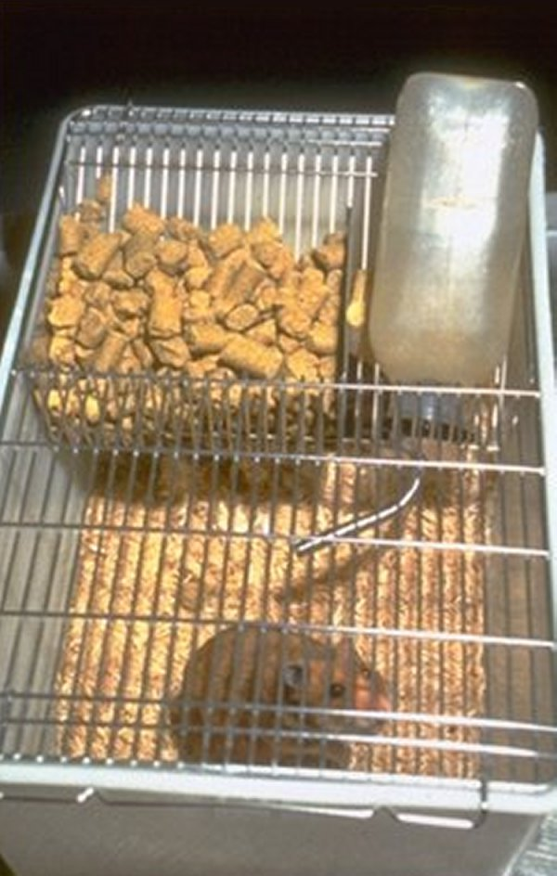
Food and Water
Average food consumption is 8 to 12 g of commercial pelleted rodent food per day for adult hamsters. Hamsters drink approximately 8-10 ml of water per 100 g of body weight per day. This rate of water consumption is similar to the gerbil, another rodent species indigenous to the desert.

Slide 27
Hibernation
Hibernation is a physiologic adaptation of many hamster species to harsh winter environments. Hamsters are permissive hibernators who may avoid hibernation if there are insufficient food stores in the burrow or may arouse from hibernation if the temperature temporarily rises.
Cold exposure is considered an important factor in inducing hibernation. Hamsters may hibernate if the temperature falls below 48°F (8°C). Testicular regression or atrophy due to decreasing photoperiod or daylight predisposes male hamsters to hibernate

Slide 28
Reproduction
Although the female hamster can be sexually mature as young as 4 to 6 weeks of age, breeding should not be allowed until the optimal age of 8 to 10 weeks.
The hamster has a 96 h or 4 day estrous cycle
Ovulation occurs during estrus—about 18-19 h into day 1.
During estrus, the female hamster is receptive to the male

Slide 29
Post-Ovulatory Discharge
This image shows the post-ovulatory discharge, which is drawn into a long string. The end of estrus and start of diestrus is marked by the appearance of this discharge, which fills the vagina and even extrudes through the vaginal orifice.

Slide 30
Gestation and Parturition
Gestation is from 15 to 16 days duration, usually averaging 16 days.
Imminent parturition is indicated by restlessness, increased respiratory rates, bloody discharge prior to delivery, and active licking of the perineal area.
Litter size usually ranges from 5 to 9 pups.
The short gestation period, 16 days compared to 21 days for rats and mice; and the large litter size make hamsters an excellent model for use in teratology or the study of the causes of fetal defects

Slide 31
Postpartum
This is a picture of 7- to 10-day-old pups with their dam. The dam and her pups should be disturbed as little as possible for the first 7 to 10 days. This is especially true if she is primiparous, as she may cannibalize or abandon the litter.

Slide 32
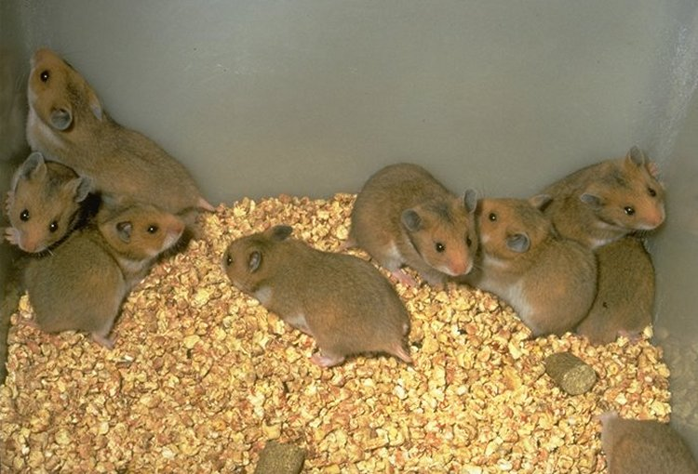
Weaning
The pups can be weaned at 21 days of age. Postpartum estrus in the Syrian hamster is infertile; the female hamster will return to estrus when the litter is weaned.
A female hamster can produce from 4 to 6 litters during her reproductive life span.

Slide 33
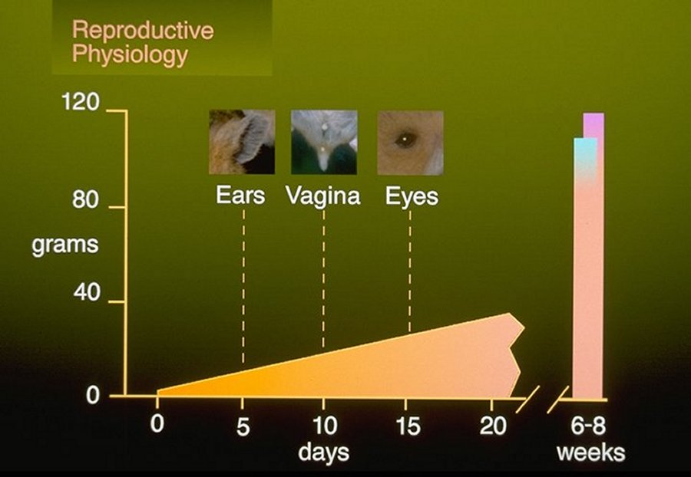
Newborn hamsters weigh from 2 to 3 g, and are hairless, with eyes and ears closed. The incisor teeth are erupted. The ears open on day 5, and eyes open on day 15. In the female hamster, the vagina opens at 10 days of age. By 21 days of age, hamsters weigh 35 to 40 g; at 6 to 8 weeks of age, they approach adult weights—the males will weigh from 85 to 110 g, and females will weigh from 95 to 120 g

Slide 34
RESEARCH USE OF SYRIAN HAMSTERS
Use in research
Hamsters are the fifth most commonly used animal in research, behind mice, rats, rabbits, and guinea pigs
Most of the hamsters used in research are outbred stocks used, for example, in cancer research, infectious disease research, and behavioral studies.
Inbred strains of hamsters have been developed for specific research use, including immunogenetics and genetic models of human diseases.

Slide 35
Cancer research
Syrian hamsters are valuable in cancer research, because they have a relatively low incidence of naturally occurring tumors when compared to other rodents. Hamsters are highly susceptible to viral oncogenesis by experimental inoculation of viruses from other species. For example, several human adenoviruses produce undifferentiated sarcomas at the site of inoculation in hamsters.

Slide 36
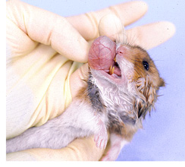
Cheek pouch
The cheek pouches have been termed immunologically privileged sites because tumors can be transplanted or induced and not readily rejected by the hamster’s immune system.

Slide 37
Infectious disease
Hamsters are utilized in infectious disease research because they are susceptible to a wide variety of bacterial, viral, and parasitic agents. The hamster has served as a model of mycoplasma infection in man as well as a model of leishmaniasis (protozoan parasites) and toxoplasmosis.

Slide 38
Epilepsy
The BlO86.93sz/Bio strain of hamster is a genetic model of epilepsy that has both a genetically determined proneness to seizure and an intrinsic trigger to induce seizures.
Spontaneous seizures can occur in hamsters from 30 to 60 days of age and may be induced by mild stress such as changing cages. Seizures last from 2 to 5 hours

Slide 39
Teratology
The Syrian hamster is valuable in experimental teratology because of the ease of obtaining timed matings, rapid embryonic development, rapid differentiation of the embryo at day 8 of development, and low rate of spontaneous malformations

Slide 45
Type of hamsters
The image below shows a Chinese hamster (left), an Armenian hamster (middle), and a Syrian hamster (right).

Slide 46
ACLAM credits
This program was developed for the American College of Laboratory Animal Medicine. C. W. McPherson, DVM Chair J. E. Harkness, DVM J. F. Harwell, Jr, DVM J. M. Linn, DVM B. J. McGough, BS Medical Communication A. F. Moreland, DVM G. L. Van Hoosier, Jr, DVM

