Slide 1
Laboratory Animal Handling Technique
- Mouse
- Rat
- Rabbit
- guinea pig

Slide 2
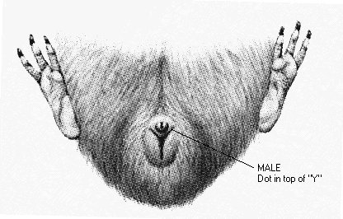

Slide 3
handling

Slide 4
IM

Slide 5
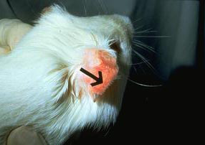
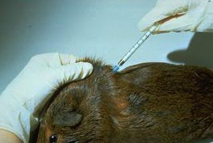
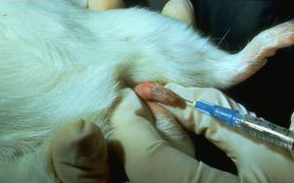
IV, IP & SC

Slide 6
