Slide 1
Laboratory Animal Handling Technique - Rabbit
A. Intramuscular injection
B. Subcutaneous injection
C. Blood collection from ear vein
D. Blood collection from carotid artery
E. Sexing

Slide 2
Intramuscular Injection in Rabbit
The most common site for administer antibiotic, tranquilizer and anesthetic

Slide 3
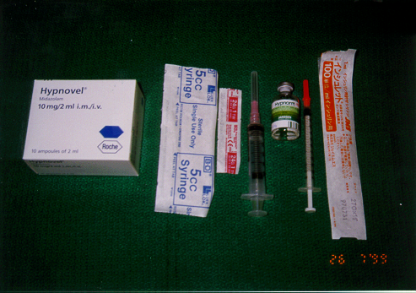
Tools for intramuscular injection in rabbit
Hypnovel and Hypnorm for general anesthesia.
75% alcohol cotton ball for surface disinfection
27G needle with 1 ml syringe
24Gneedle with 5ml syringe

Slide 4
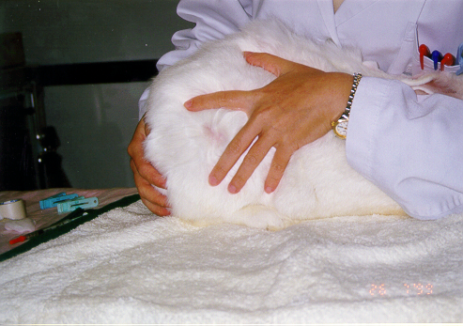
Disinfect of skin on the top of thigh muscle

Slide 5
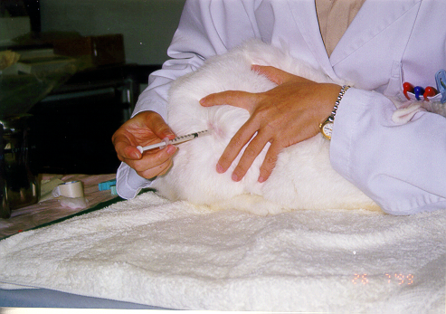
Insert needle perpendicular to the surface of skin and inject the substance inside the syringe

Slide 6
Subcutaneous Injection in Rabbit
The most common method for immunology study

Slide 7
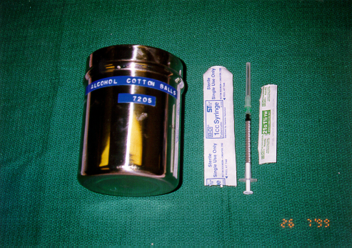
Tools for subcutaneous injection in rabbit
75% alcohol cotton ball for surface disinfection
21 G needle with 1 ml syringe for injection

Slide 8
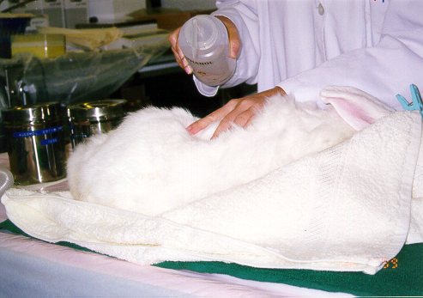
Disinfect of injection site by 75% alcohol directly or 75% alcohol cotton ball

Slide 9
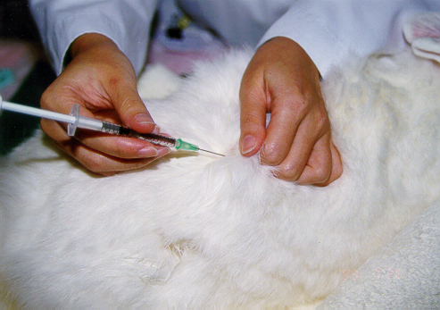
Pinch the skin up and insert the needle in for injection

Slide 10
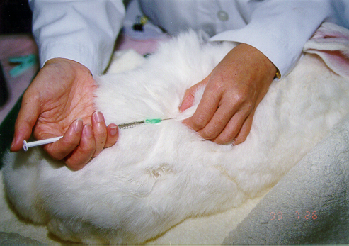
Keep the needle tip in skin for a while after injection to prevent leakage of substance from the needle which due to imbalance pressure of emulsion inside the syringe.

Slide 11
Collection of Blood from Ear Vein in Rabbit
A common location for small amount of blood collection
May use tranquilizer for nervous rabbit or small size rabbit

Slide 12
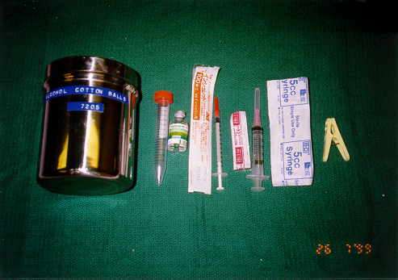
Tools for blood collection from ear vein
75% alcohol cotton ball for surface disinfection
27G needle with 1 ml syringe for apply of tranquilizer
24G needle with 5 ml syringe for blood withdraw
15 ml centrifuge tube for blood collection
a plastic clip and a cotton ball for prevention of further bleeding

Slide 13
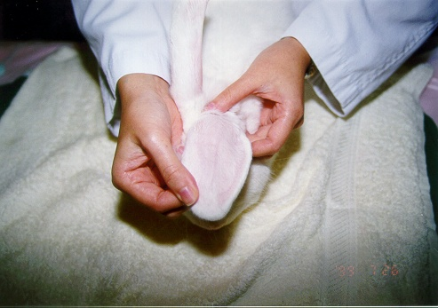
Ear vein before administering of tranquilizer

Slide 14
Ear vein after administering of tranquilizer

Slide 15
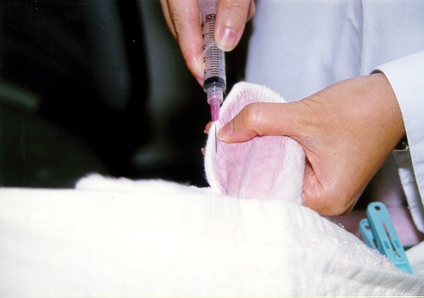
Insert needle into the ear vein with needle tip surface face up

Slide 16
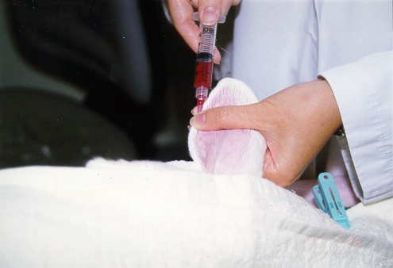
Fix the position of needle by your left thumb and withdraw blood from the ear vein

Slide 17
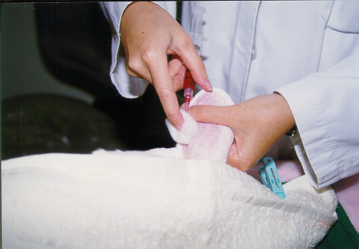
Press a cotton ball on the top of the injection site before pull out the needle.

Slide 18
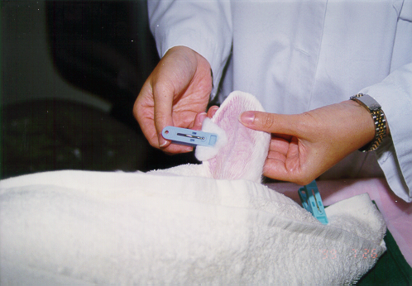
Apply clip on the top of the cotton ball for 2-3 minutes to stop further bleeding

Slide 19
Whole Blood Collection from Carotid Artery in Rabbit
Must under general anesthetic
May collect blood amount up to 4 % of body weight

Slide 20
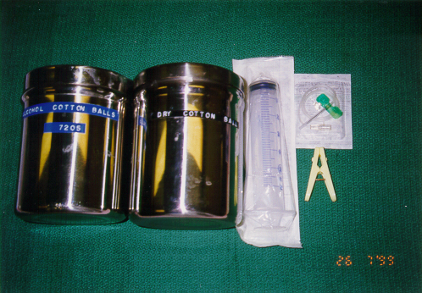
Tools for collecting 50ml blood from ear artery
75% alcohol cotton ball for disinfect of ear surface
21 G winged infusion set with 50 ml syringe for blood collection
Dry cotton ball and plastic clip for prevention of further bleeding

Slide 21
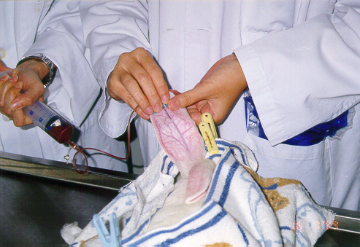
Apply same procedure as collecting blood from ear vein for blood collection from ear artery

Slide 22
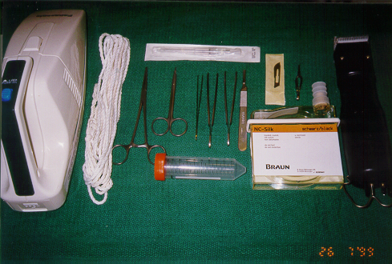
Tools for blood collection from carotid artery
Electric clipper
Vacuum cleaner
Scalpel blades and handle
Tissue forceps x2
Scissors
Bulldog clamp
Homeostatic forceps
3 - 000 silk suture
16G Intravenous catheter
50 ml Centrifuge tubes

Slide 23
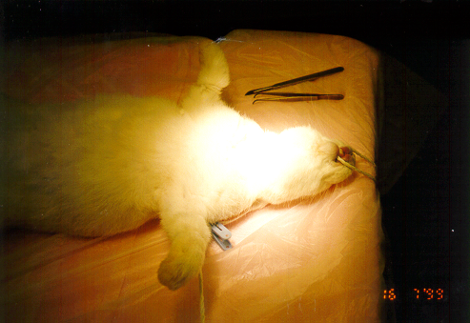
Restrain the anesthetized rabbit on the surgical table

Slide 24
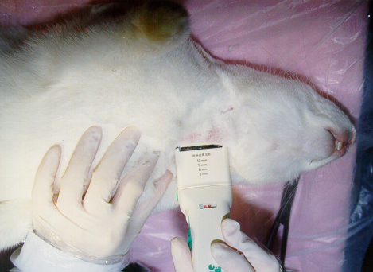
Remove the hair around the neck area

Slide 25
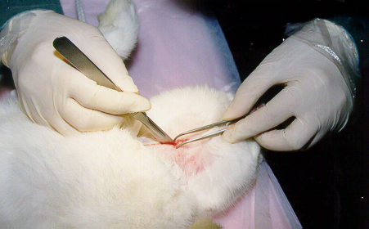
Make a 5 cm opening on the middle line of the neck

Slide 26
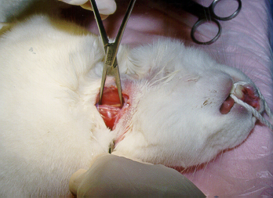
Search the carotid artery with a tissue forceps and a homeostatic forceps.

Slide 27
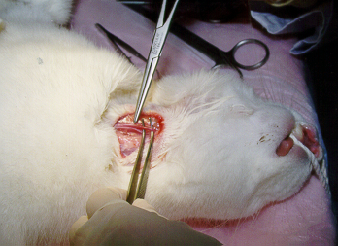
Isolate the carotid artery from the vagus nerve and other connective tissue

Slide 28
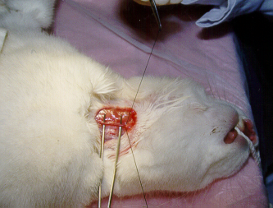
Tie up the distal end of the carotid artery by silk suture

Slide 29
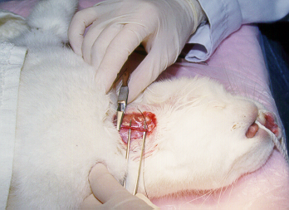
Clip the proximal end of the carotid artery with a bulldog clamp

Slide 30
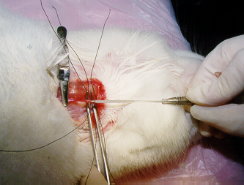
Insert a 16 G intravenous catheter into the artery

Slide 31
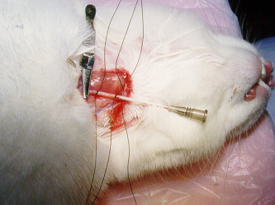
Fix the position of the catheter tip by two silk suture knots

Slide 32
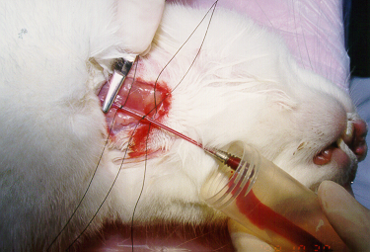
Release the bulldog clamp and collect blood from the artery though the catheter into the centrifuge tube

Slide 33
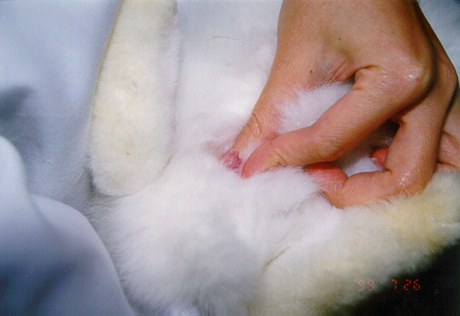
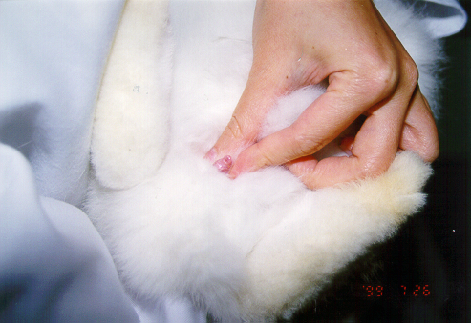
Slight pressure is applied to the external genitalia to expose the vulva of a female bunny
Slight pressure is applied to the external genitalia to expose the penis of a male bunny

Slide 34
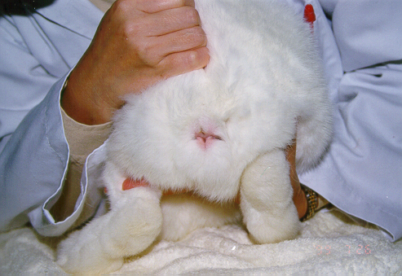
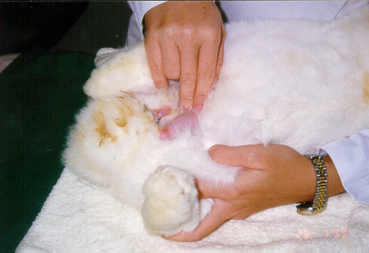
A female rabbit
A male rabbit

