Slide 1
Laboratory Animal Handling Technique
- Mouse
- Rat
- Rabbit

Slide 2
Objective
To comply with the Animal Welfare Ordinance and avoid mishandling of animal in research
To provide basic concepts of animal handling technique to new animal user
While offering our concept and techniques to our animal user, we also encourage comments from experienced animal users. By doing so, we would enrich our knowledge in the field of laboratory animal research on both sides and further benefit animal welfare as well as the credibility of research result in our university

Slide 3
Laboratory Animal Handling Technique - Mouse
A. Blood collection from tail vein
B. Blood collection from orbital sinus
C. Blood collection from cardiac puncture
D. Blood collection from saphenous vein
E. Intraperitoneal injection
F.Subcutaneous injection
G. Oral Feeding
H. Sexing

Slide 4
Blood Collection From Tail in Mouse
For collection of small amount of blood (Approximate 0.1 ml )

Slide 5
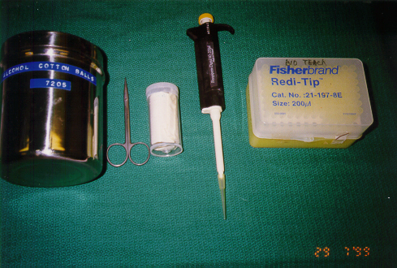
Tools for Blood Collection from Tail
75% alcohol cotton ball for surface disinfection
Small plastic bottle with 1/2 cm diameter holes in both ends as mouse restrainer
Scissors
Pipetteman and tips
A vial for blood collection

Slide 6
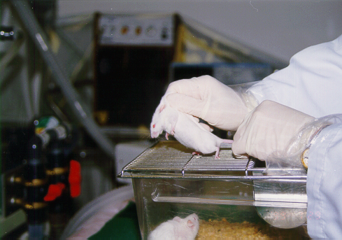
Placing a mouse on a cage lid and grasping the loose skin behind the ears by the thumb and forefinger

Slide 7
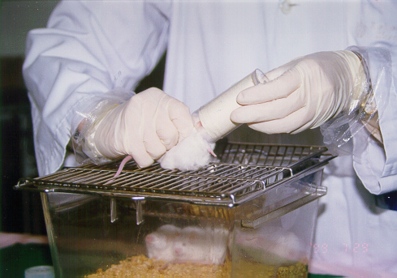
Push the mouse into the restrainer

Slide 8
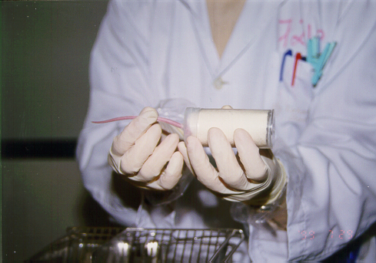
Leave the tail of the mouse outside the cover of the restrainer

Slide 9
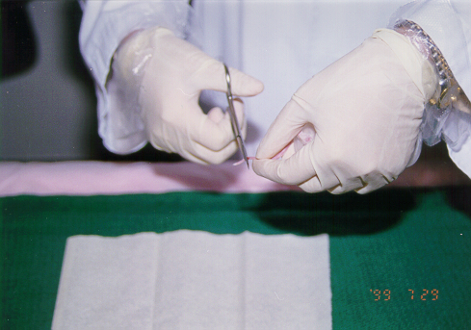
Amputate the tip of the mouse tail by scissors

Slide 10
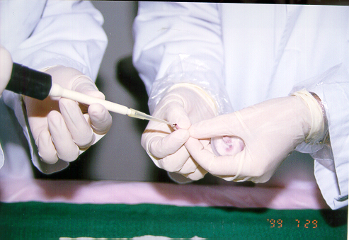
Massage the tail and collect blood by pipetteman

Slide 11
Blood Collection From Orbital Sinus in Mouse
Should apply anesthetic before blood withdraw
A convenience and easy apply method for blood collection in mouse
Collect amount up to 0.5 ml

Slide 12
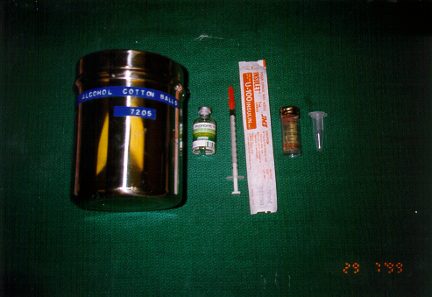
Tools for Blood Collection from Orbital Sinus in Mouse
75% alcohol cotton ball for surface disinfection
Hypnorm for general anesthetic
27 G needle with 1 ml syringe for injection
Glass capillary tube and vial for blood collection

Slide 13
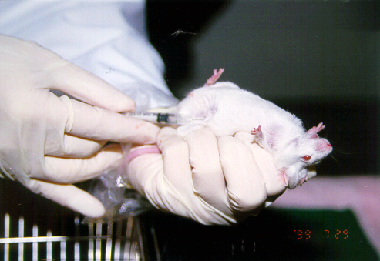
Anesthetize a mouse by intraperitoneal injection of Hypnorm

Slide 14
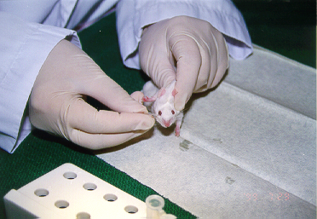
Use a sharp end glass capillary tube to penetrate the orbital conjunctiva and rupture the orbital sinus

Slide 15
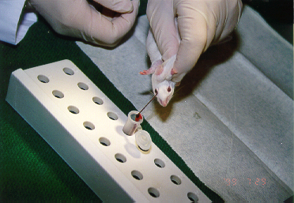
Collect blood with a vial

Slide 16
Blood Collection From Cardiac Puncture in Mouse
For collect up to 1 ml of blood within a short period of time
Must be performed under general anesthetic

Slide 17
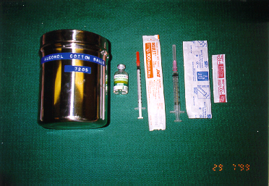
Tools for Cardiac puncture in Mouse
75% alcohol cotton ball for surface disinfection
Hypnorm used as anesthetic
27G needle with 1 ml syringe for injection
24G needle with 3 ml syringe for blood withdraw

Slide 18
Anesthetize a mouse by intraperitoneal injection of Hypnorm

Slide 19
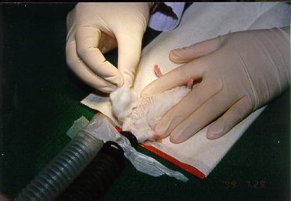
Disinfect the thorax area with 75% alcohol cotton ball

Slide 20
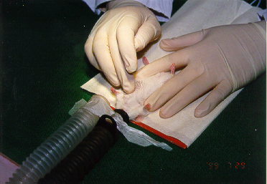
Search for the maximum heart palpitation with your finger

Slide 21
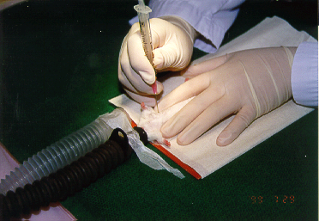
Insert a 24G 1” needle through the thoracic wall at the point of maximum heart palpitation

Slide 22
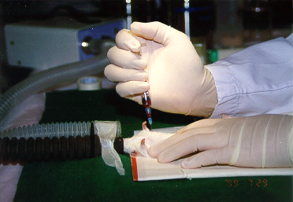
Withdraw blood slowly by your right hand

Slide 23
Blood Collection From Saphenous Vein in Mouse
This method is used of multiple samples are taken in the course of a day
It can also be applied on rats, hamsters, gerbils and guinea-pigs

Slide 24
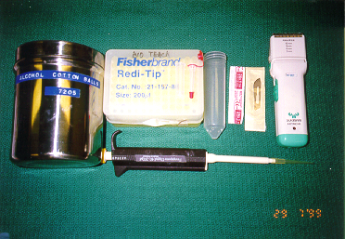
Tools for blood collection from Saphenous vein in mice
75% alcohol cotton ball for surface disinfection
50 ml syringe tube with small holes at the end as restrainer
a scalpel and shaver for remove of hair
24 G 1 “ needle for release of blood
tips and pipetteman for blood collection

Slide 25
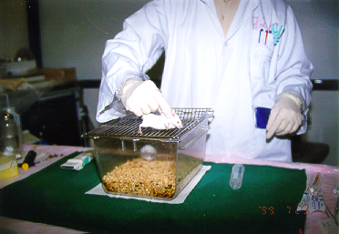
Placing a mouse on a cage lid and grasping the loose skin behind the ears with your thumb and forefinger

Slide 26
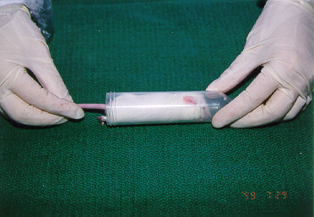
Place the mouse in the restainer

Slide 27
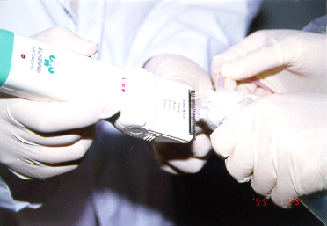
Pull out the leg and removed the hair by a assistant

Slide 28
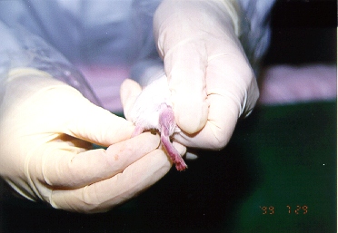
Hair can also be shaved by using a small scalpel

Slide 29
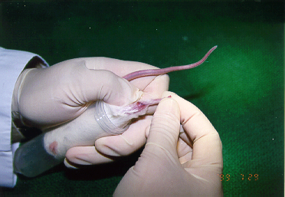
The saphenous vein is seen on the surface of the thigh

Slide 30
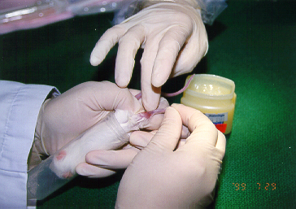
Apply vaseline after disinfect the surface area to reduce clotting and coagulation during blood collection.

Slide 31
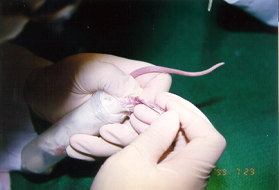
Use a 24 G 1” needle to puncture the vein and release blood from the saphenous vein

Slide 32
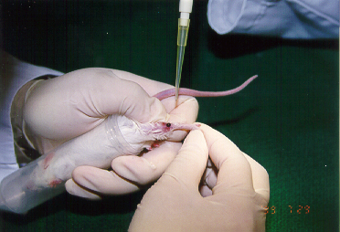
Use a Microvette or a pipetteman with tip to collect blood from the saphenous vein

Slide 33
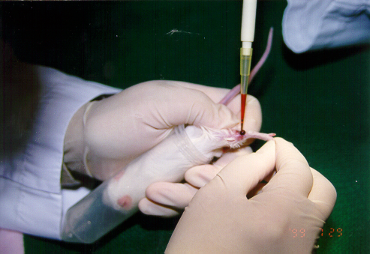
Approximate 100 microliters can be collected

Slide 34
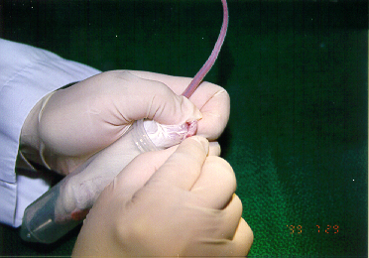
Flex the foot of the mouse to reduce the flow of blood back to the puncture site

Slide 35
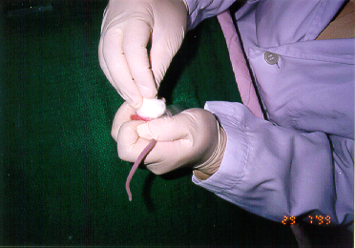
A cotton ball is applied to the puncture site to stop further bleeding

Slide 36
Intraperitoneal Injection in Mouse
A common method of administering drugs to rodents

Slide 37
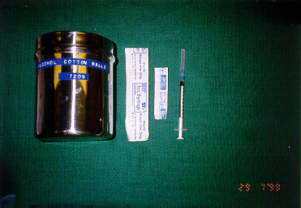
Tools for Intraperitoneal Injection in Mouse
75% alcohol cotton ball for surface disinfection
25G 1/2” needle with 1 ml syringe for injection

Slide 38
Place a mouse on a cage lid and grasping the loose skin behind the ears with your thumb and forefinger

Slide 39
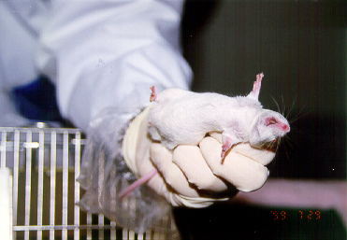
As soon as the mouse’s head is restrained, the mouse can be picked up and the tail secured within your ring finger and little finger

Slide 40
The injection site should be in the lower left quadrant of the abdomen because vital organs are absent from this area. Only the tip of the needle should penetrate the abdominal wall to prevent injection into the intestine.

Slide 41
Subcutaneous Injection in Mouse
The most common method for immunology studies

Slide 42
Tools for Subcutaneous Injection in Mouse
75% alcohol cotton ball for surface disinfection
25G 1 “ needle with 1 ml syringe for injection

Slide 43
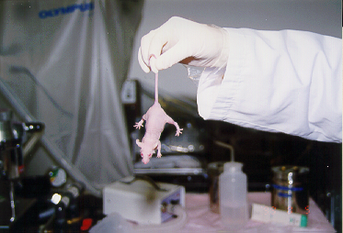
Pick up a nude mouse and spin it’s tail to put it in a faint condition

Slide 44
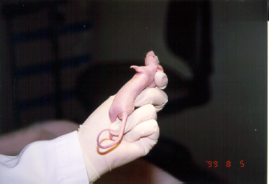
Grasp the loose skin on the back of the mouse from ears along the legs and restrain the legs with your ring finger and little finger

Slide 45
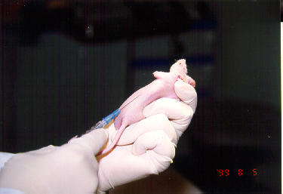
After disinfect the surface area, insert the needle in the lateral side of the abdominal wall and push upwards to the armpit of the mouse

Slide 46
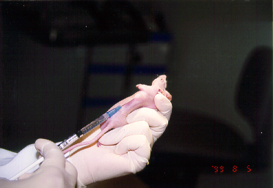
Inject the substance slowly

Slide 47
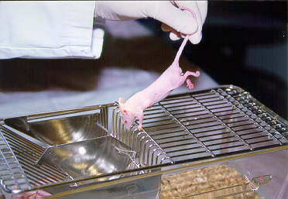
A lump of injection substance can be seen through the skin after injection

Slide 48
Oral Feeding in Mouse
Gastric intubation ensures that all the material was administered
Feeding amount limited to 1% of body weight

Slide 49
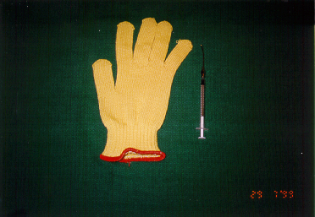
Tools for Oral Feeding in Mouse
A 18 G stainless steel, ball tipped needle
a glove

Slide 50
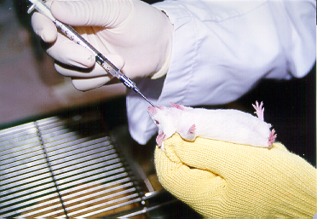
Grasp the loose skin on the back of the mouse and restrain it’s tail with your ring finger and little finger. Then, introduce the feeding tube from the pharynx in to the esophagus when the mouse is in the act of swallowing.

Slide 51
Common complications associated with gastric intubation are damage to the esophagus and administration of substance into the trachea. Careful and gentle passage of the feeding needle will greatly reduce these possibilities.

Slide 52
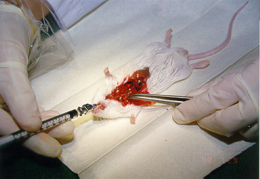
The anatomy picture showed the position of the feeding needle tip inside the esophagus with the heart and sternum removed.

Slide 53
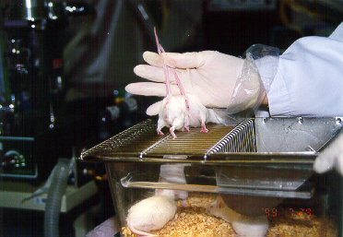
Sexing mice - The distance between the anal and genital orifices is greater in the male (left) compared to the female (right).

