Slide 1
Laboratory Animal Handling Technique
- Mouse
- Rat
- Rabbit

Slide 2
Objective
To comply with the Animal Welfare Ordinance and avoid mishandling of animal in research
To provide basic concepts of animal handling technique to new animal user
While offering our concept and techniques to our animal user, we also encourage comments from experienced animal users. By doing so, we would enrich our knowledge in the field of laboratory animal research on both sides and further benefit animal welfare as well as the credibility of research result in our university

Slide 3
Laboratory Animal Handling Technique - Rat
A.Intraperitoneal injection
B.Blood collection from tail vein
C.Blood collection from cardiac puncture
D. Oral feeding
E. Sexing

Slide 4
Intraperitoneal Injection in Rat
The most common method of administering drugs to rats

Slide 5
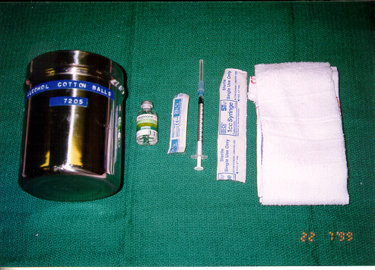
Tools for intraperitoneal injection in rat
75% alcohol cotton ball for surface disinfection
medium size towel for restraining the rat
25G 5/8” needle with 1cc syringe for injection

Slide 6
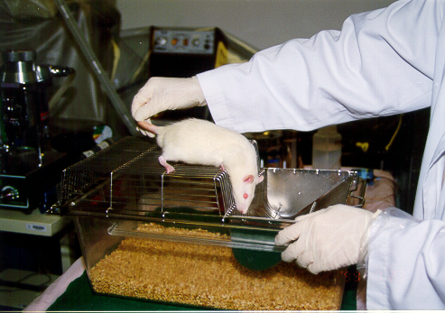
Let the rat relaxes on the top of the lid.

Slide 7
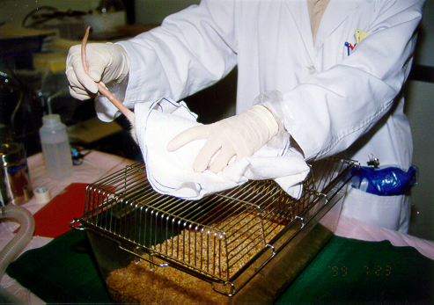
Stretch the body of the rat by pulling up it’s tail and then cover the rat with a towel by your left hand

Slide 8
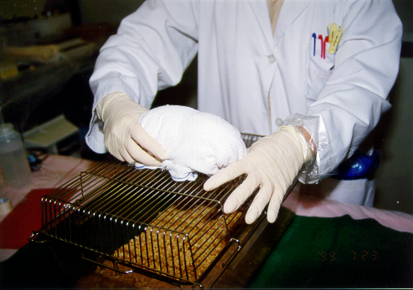
Fold the skirts of towel under the rat from all directions

Slide 9
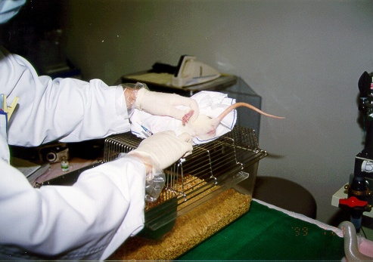
Grasp up the left hindlimb of the rat to expose the abdomen

Slide 10
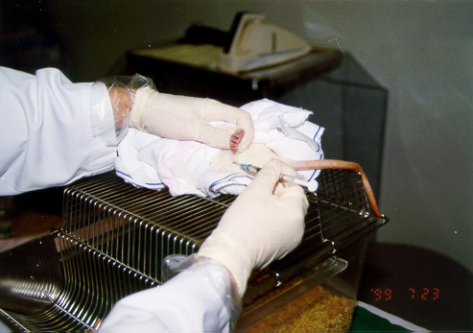
The injection site should be in the lower left quadrant of the abdomen because vital organs are absent from this area

Slide 11
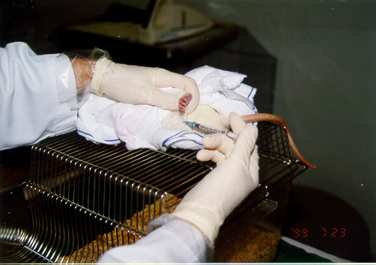
Only the tip of the needle should penetrate the abdominal wall to prevent injection into the intestines.

Slide 12
Collection of blood from tail vein in rat
General anesthesia needed
small amount: 0.1-1 ml

Slide 13
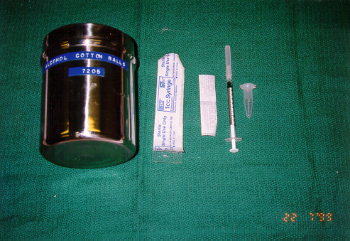
Tools for collection of blood from tail vein
75% alcohol cotton ball for surface disinfection
27G1/2” needle with 1 ml syringe for blood withdrawal
a vial for blood collection

Slide 14
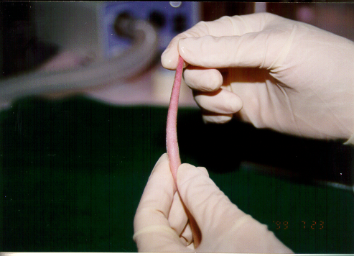
Optimal site of blood withdrawal is around the distal one-third of the tail since this part of tail gives better visualization of the veins

Slide 15
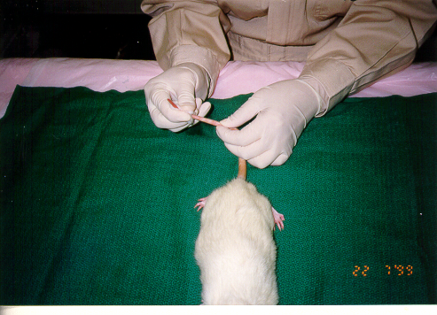
Disinfect the tail with 75% alcoholic cotton ball

Slide 16
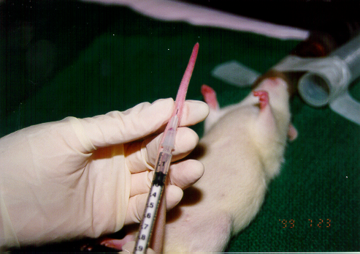
When the needle penetrates the epithelium of the tail, pull back the plugger a bit to create negative pressure inside the syringe, then push the needle in the vein slowly until blood get into the dead space of the needle head

Slide 17
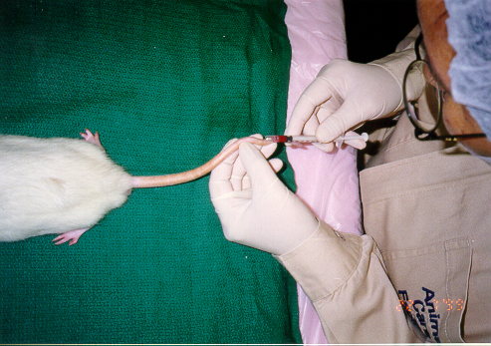
Pull back the plugger by the ring finger to withdraw blood from the tail vein

Slide 18
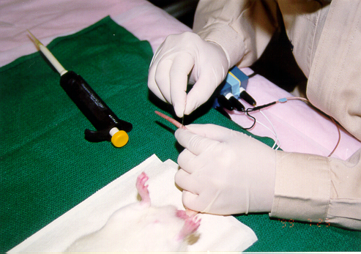
Using a scalpel to make a small wound on the tail is also an option for collecting blood from tail vein

Slide 19
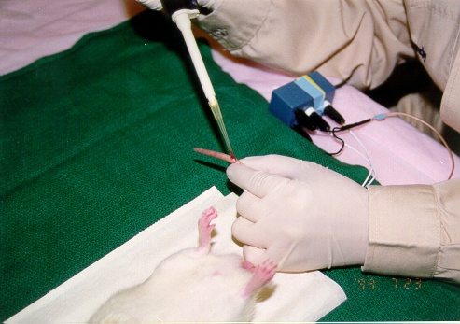
Blood can be collected b using a pipetteman after then

Slide 20
Collection of Blood from Cardiac puncture in Rat
General anesthesia needed
Large amount: up to 3% of body weight

Slide 21
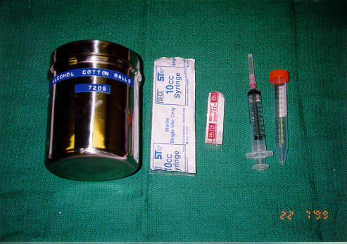
Tools for collection of blood from cardiac puncture
75% alcohol cotton ball for surface disinfection
24G needle with 10cc syringe for blood withdraw
15 cc centrifuge tube for blood collection

Slide 22
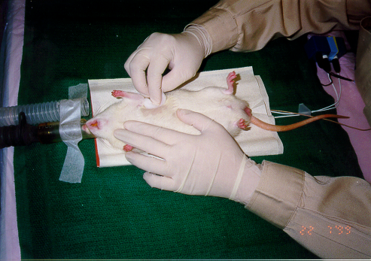
Disinfect the left thorax with 75% alcoholic cotton ball

Slide 23
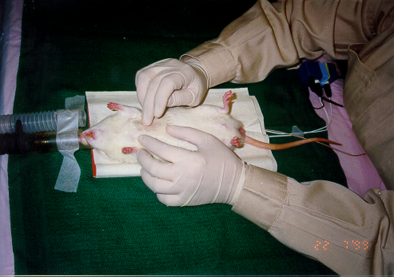
Search for the point of maximum heart beat

Slide 24
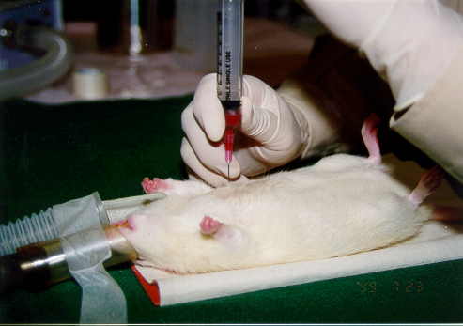
Insert the needle straight on the selected point and withdraw blood by your left hand

Slide 25
Oral Feeding in Rat
Feeding amount limited to 1% of body weight

Slide 26
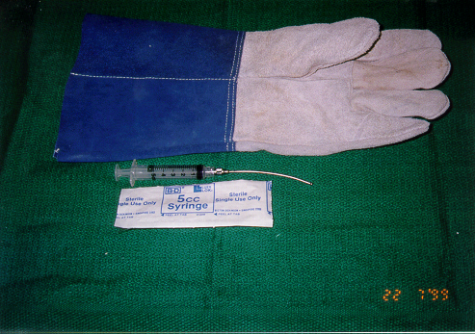
Tools for oral feeding in rat
16 G ball-tipped feeding needle with syring
Leather glove

Slide 27
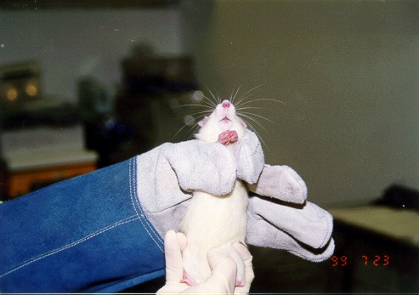
Restrain the shoulders of the rat by your thumb and index finger, then support the lower limbs with your right hand

Slide 28
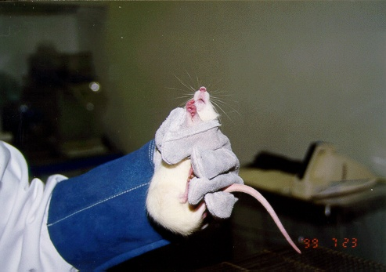
Restrain the tail of the rat in between your ring finger and little finger

Slide 29
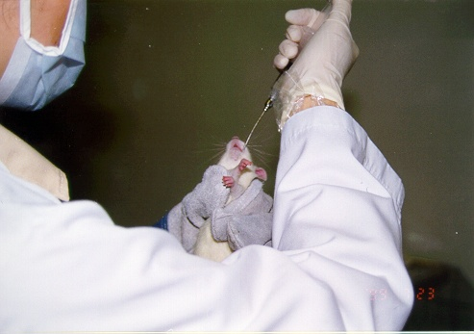
Let the rat lying on your left palm and introduce the ball-tipped feeding needle from the pharynx in to the esophagus when the rat is in the act of swallowing

Slide 30
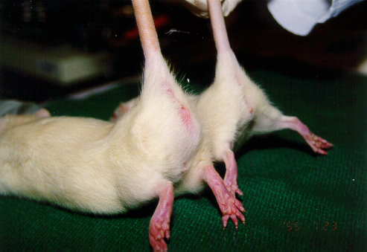
Sexing Rat- the distance between the anal and genital orifices is greater in the male (left) compared to the female (right)

